Slide 1
CNN (Convolution Neural Networks)

Slide 2
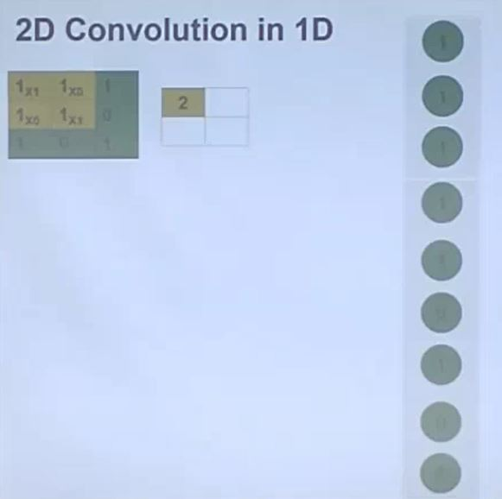

Slide 3
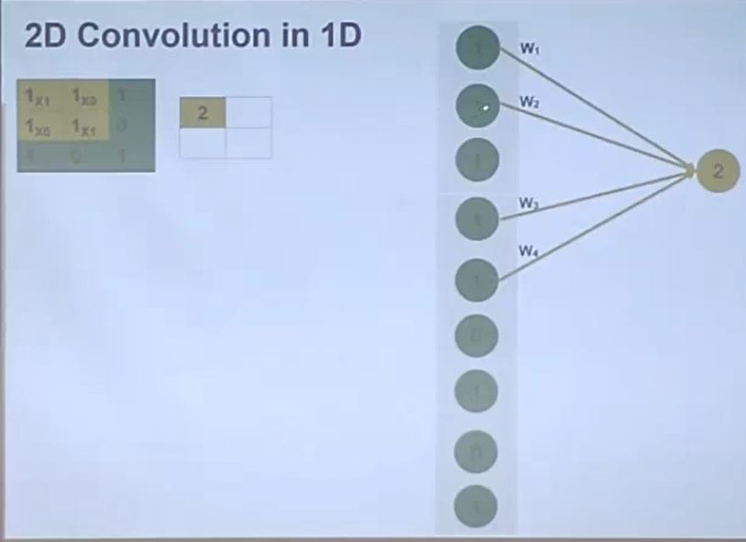

Slide 4
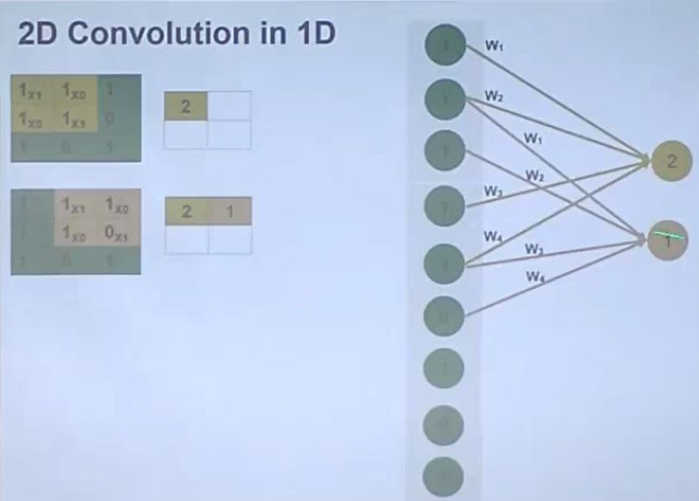

Slide 5
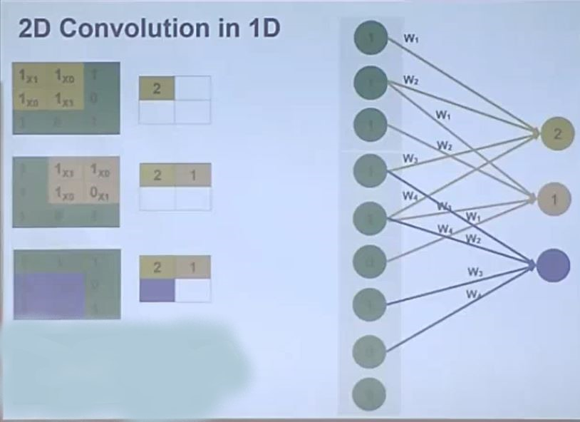

Slide 6
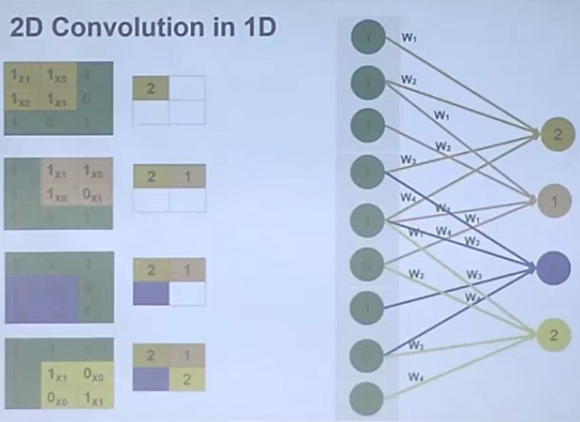

Slide 7
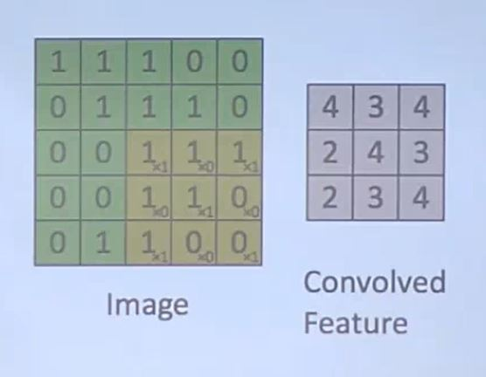

Slide 8
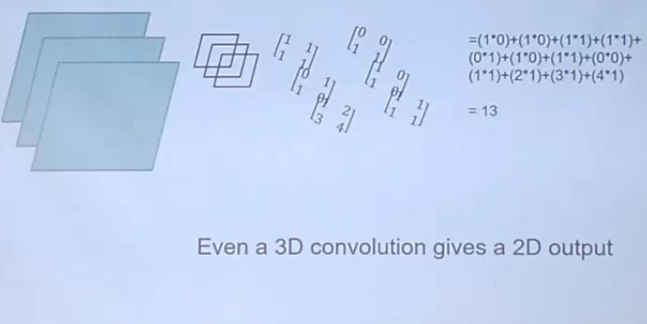

Slide 9
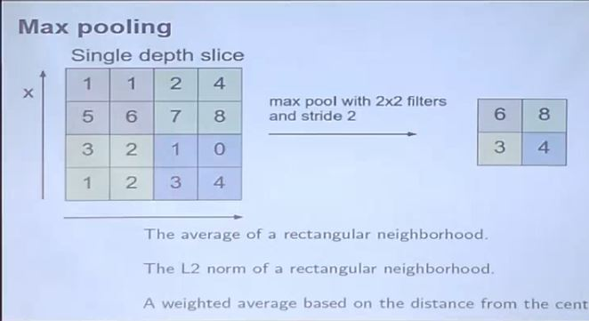

Slide 12
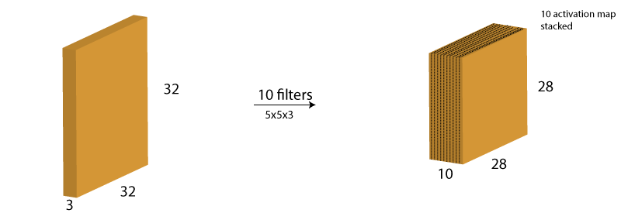

Slide 13
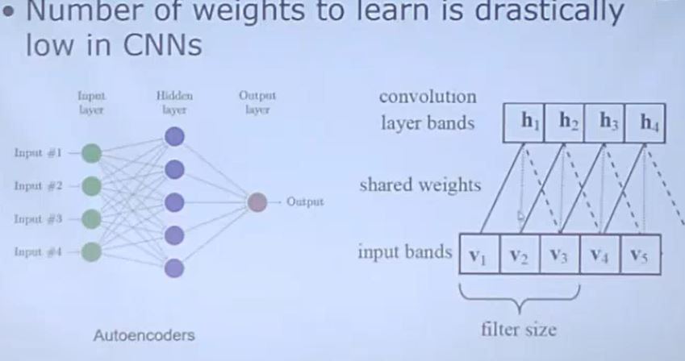
Advantages of CNN

Slide 14
Different Layers
A Convolutional Neural Network(CNN) architecture has three main parts: A convolutional layer that extracts features from a source image. Convolution helps with blurring, sharpening, edge detection, noise reduction, or other operations that can help the machine to learn specific characteristics of an image. A pooling layer that reduces the image dimensionality without losing important features or patterns. A fully connected layer also known as the dense layer, in which the results of the convolutional layers are fed through one or more neural layers to generate a prediction. In between the convolutional layer and the fully connected layer, there is a ‘Flatten’ layer. Flattening transforms a two-dimensional matrix of features into a vector that can be fed into a fully connected neural network classifier.

Slide 15
